Slide 1
CS 211 Computer Architecture
Lab 04

Slide 2
Stacks
A stack is a region of memory for holding data that is dynamically created.
Stack follows “Last in First out approach”
Elements added most recently, will be used first.
Just like a stack of plates.

Slide 3
Stack in MIPS
Each data element in the stack is a 32 bit word.
To locate elements in stack, a special register, by the name ‘stack pointer’ is used ($sp)
The $sp register points to the top of the stack.
The MIPS stack grows downward in memory.
For each insert, the $sp register should be decremented by 4, before inserting the element.

Slide 4
Stack in MIPS
Here is what that looks like in code.
Say that the value to push on the stack is in register $t0:
subu $sp,$sp,4 # point to the place for the new item
sw $t0,($sp) # store the contents of $t0 as the new top

Slide 5
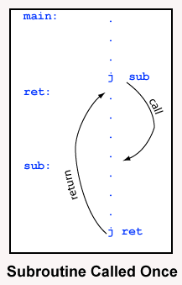
Subroutines
A subroutine is a logical division of the code that may be regarded as a self-contained operation.
j instruction, moves to the location
pointed by the label, specified in
the instruction.
At the end of the subroutine, another j
instruction can be used to return to required
location

Slide 6
Subroutine linkages
But what if the same subroutine has to be called at multiple locations?
The return instruction will pose a problem.
jal instruction stores the return address in $ra.
This makes sure that $ra holds the different return locations, when same subroutine is called from different locations.
At the end of the subroutine, jr instruction will move to the the address held by $ra

Slide 7
jal and jr instructions
jal sub # $ra=PC+4, PC=sub
jr $ra #PC=$ra

Slide 8
Stacks and Subroutines
In case of nested subroutines, stacks can be used to hold the $ra values respectively.
Subroutines can also be global, in which case they can be accessed by other files as well.

